Slide 1

Create your first virtual healthcare assistant with Azure Health Bot
Christina Pardali
Beta Microsoft Learn Student Ambassador

Slide 2



Who am I ?
Christina Pardali
Beta Microsoft Learn Student Ambassador
Electrical and Computer Engineering Student
Aristotle University of Thessaloniki
Greece
linkedin.com/in/christine-pardali/
github.com/ChristinaPa

Slide 3
Introduction to Azure Health Bot

Slide 4
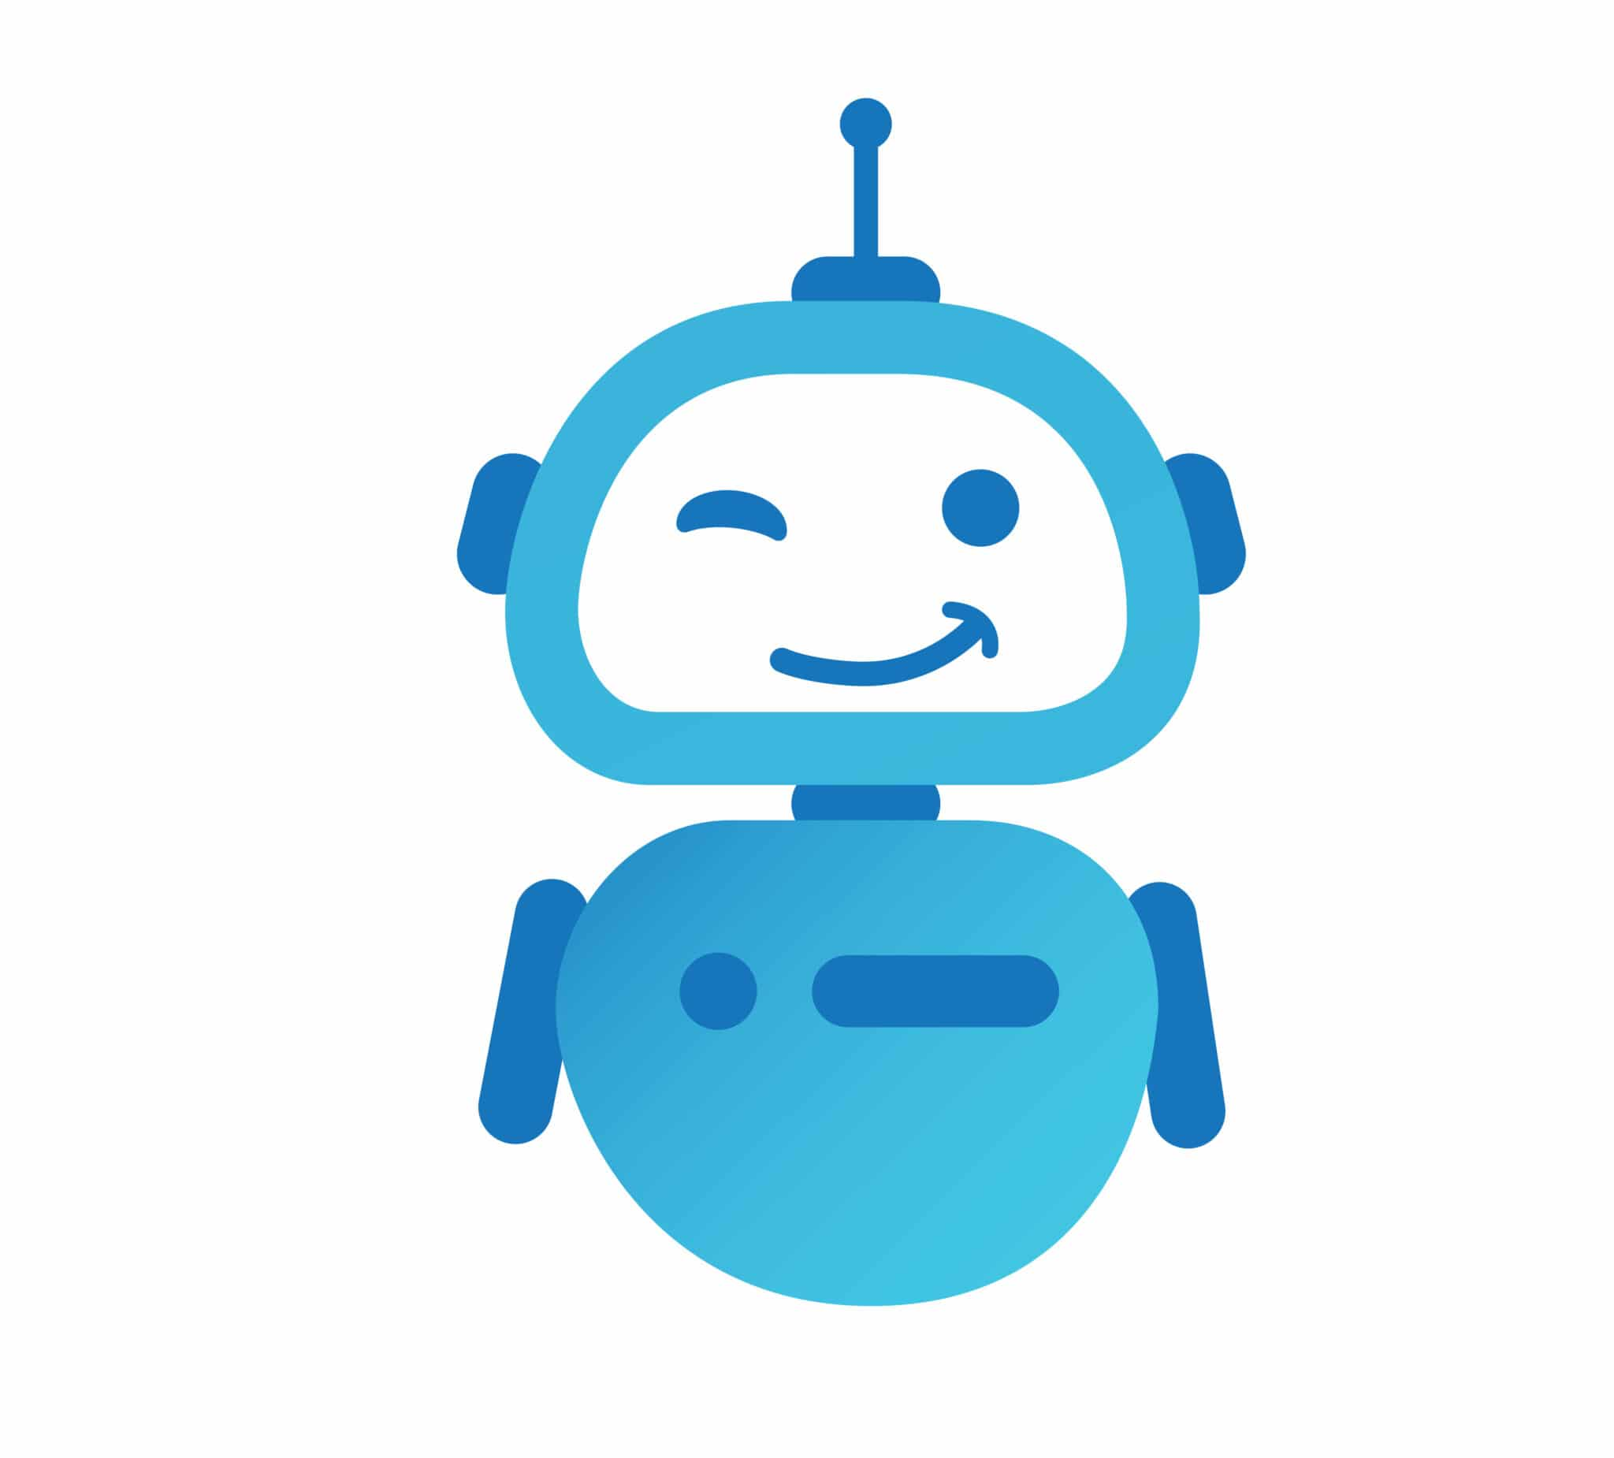
What is a bot?
Bots are programmed to perform specific repetitive tasks.
Bots are thus computer programs that operate autonomously and do not depend on human input or supervision to perform their functions.

Slide 5
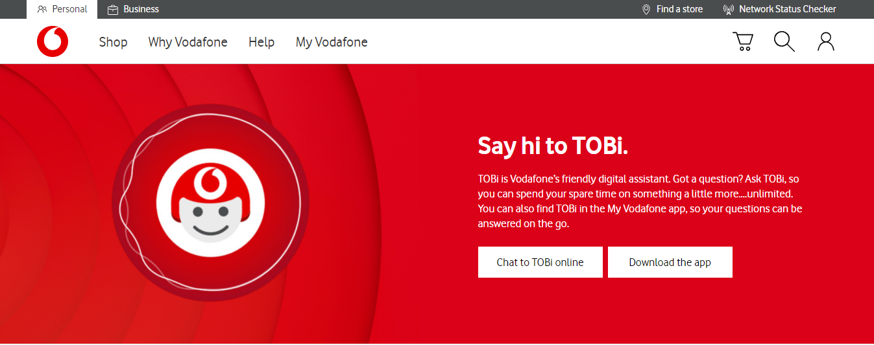
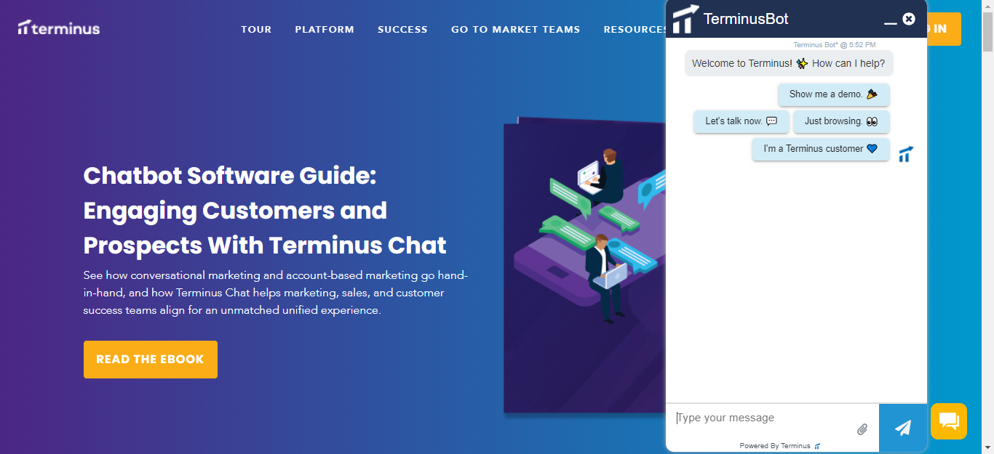
Bots in everyday life

Slide 6

Azure Health Bot
The Health Bot Service is a cloud platform that empowers developers in Healthcare organizations to build and deploy their compliant and AI-powered virtual health assistants.

Slide 7
Who can use it?
Pharmaceutical
companies
Tele-medicine
providers
Health insurers

Slide 8
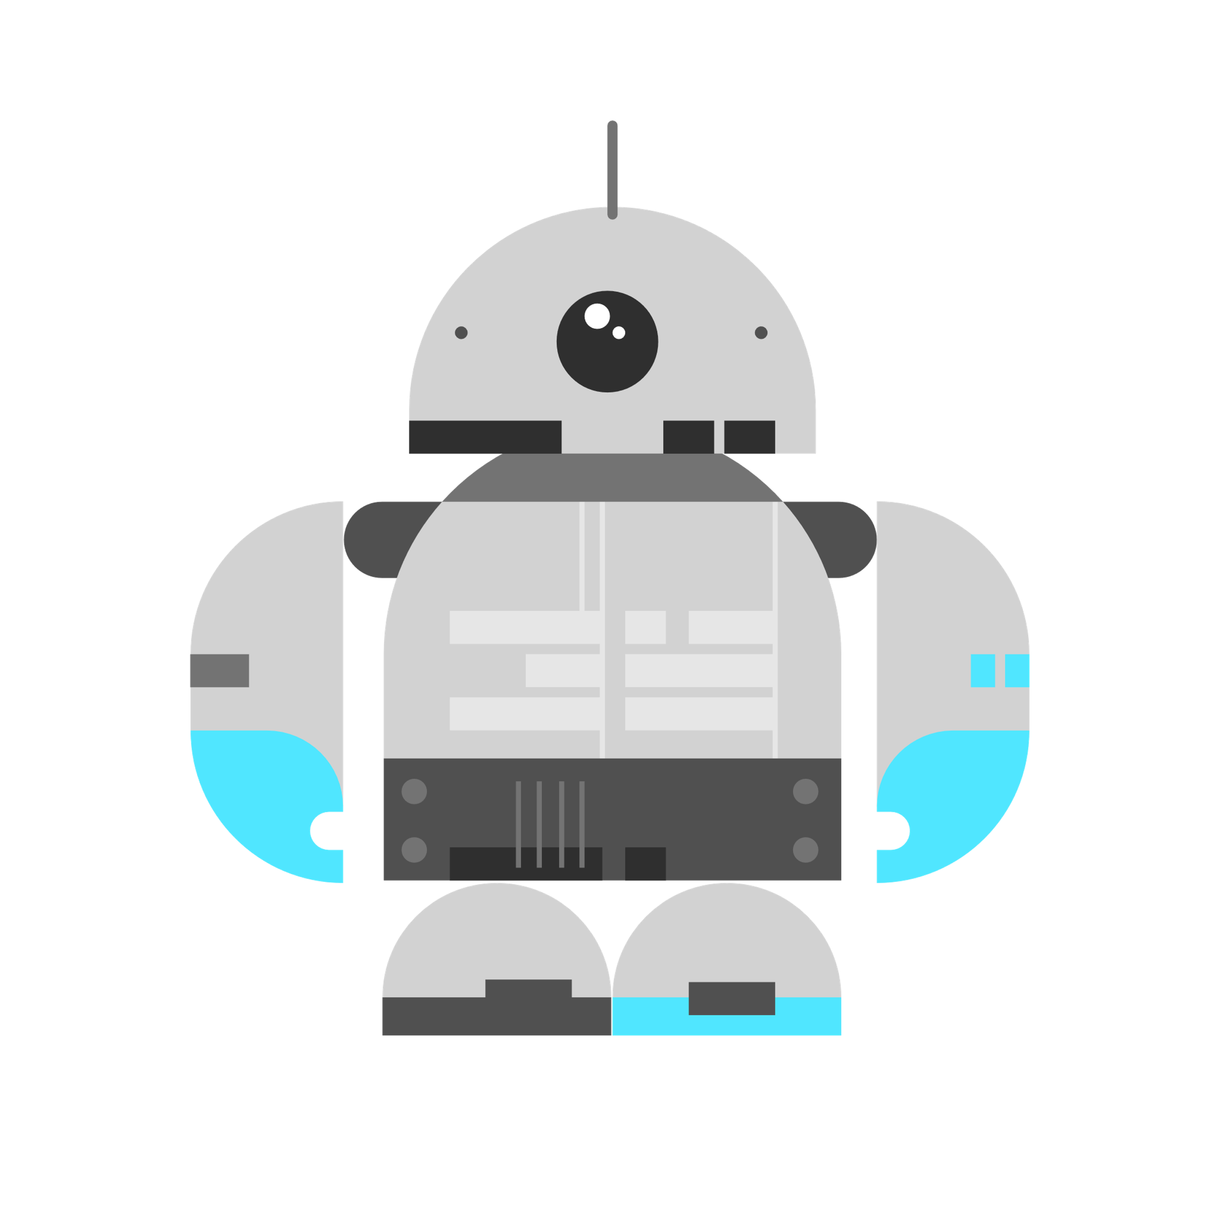
Why use Azure Health Bot Service
An extensible management portal
Healthcare-specific configuration options
Built in triage and symptom checker
Integration with Language Understanding Intelligent Service (LUIS

Slide 9
...more benefits
Customization options
Connection with partners' information systems.
Integration into other systems such as web sites, chat channels, and digital personal assistants.

Slide 10
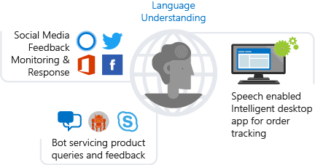
What is LUIS
Language Understanding (LUIS) is a cloud-based conversational AI service that applies custom machine-learning intelligence to a user's conversational, natural language text to predict overall meaning, and pull out relevant, detailed information.

Slide 11
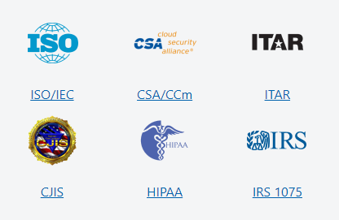

Security and Privacy
The Health Bot is HIPAA-ready and has a list of certifications.

Slide 12
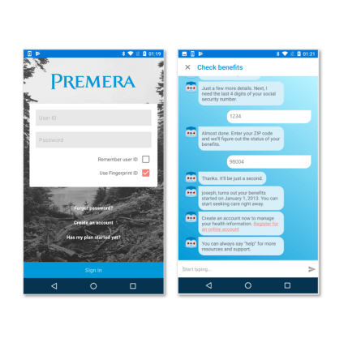
Case studies
Premera Blue Cross improved patient experience through faster response by implementing "Scout", their intelligent virtual health assistant that offers digital services such as checking healthcare claim status, eligibility and health plans on Android and IOS.

Slide 13
Demo: Create your first Health Bot

Slide 14
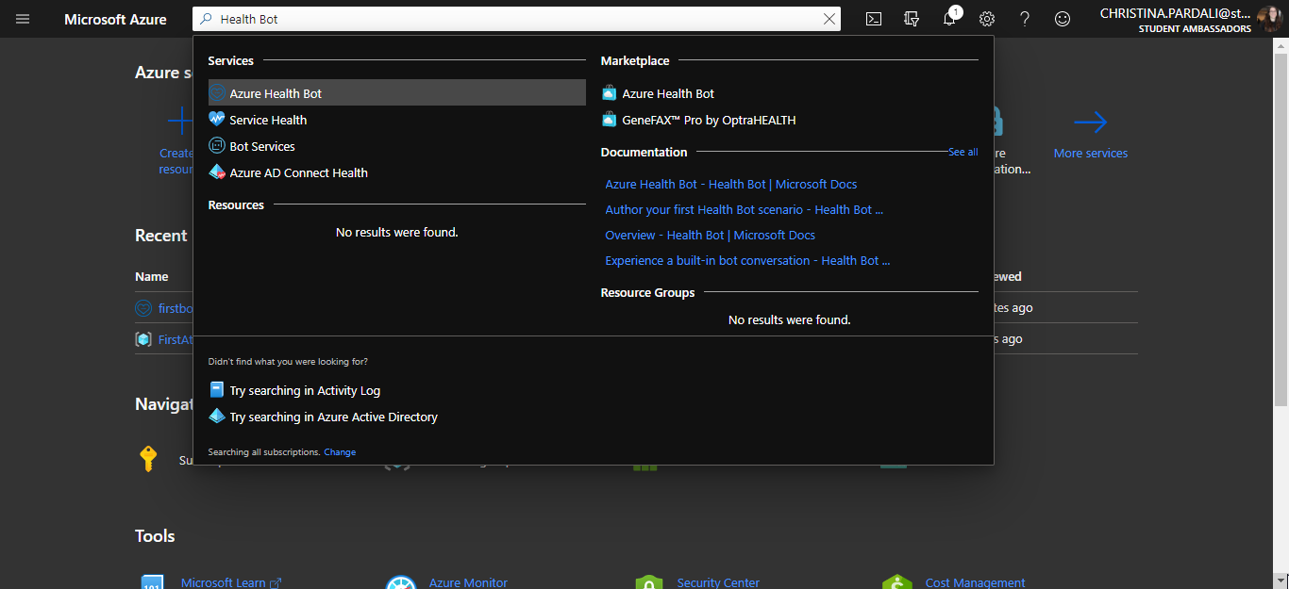
Create your first Health Bot Demo

Slide 15
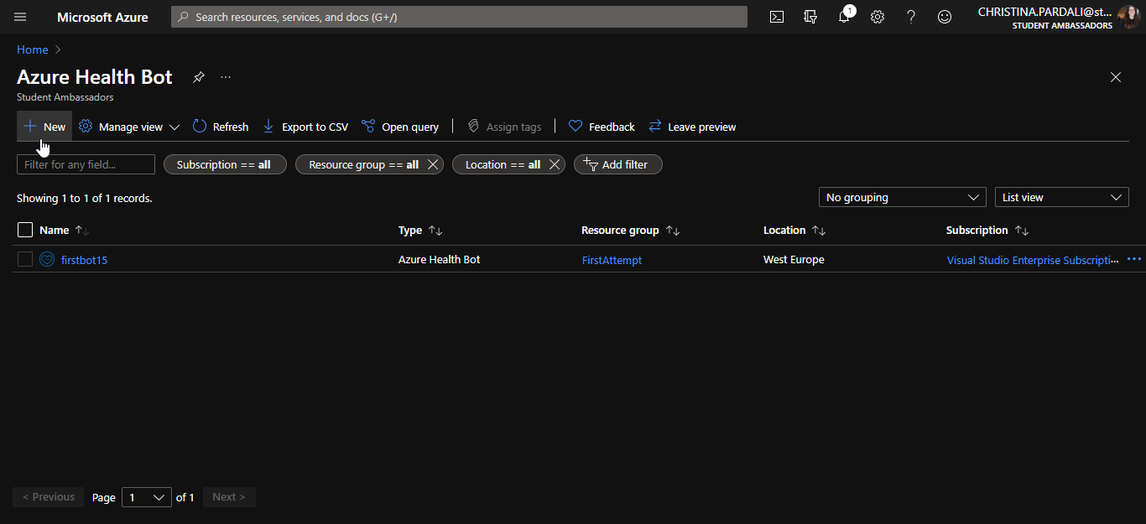
Create your first Health Bot Demo

Slide 16
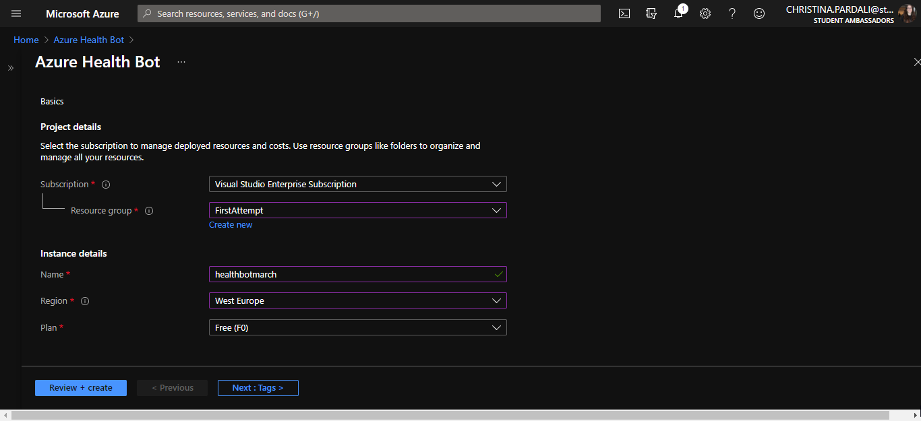
Create your first Health Bot Demo

Slide 17
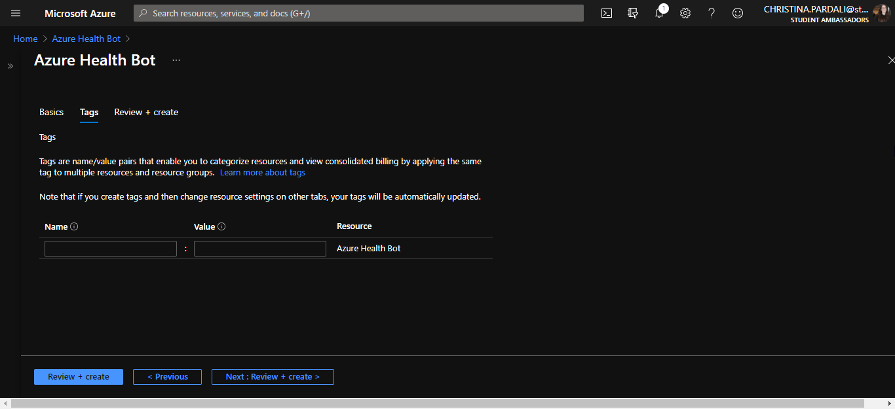
Create your first Health Bot Demo

Slide 18
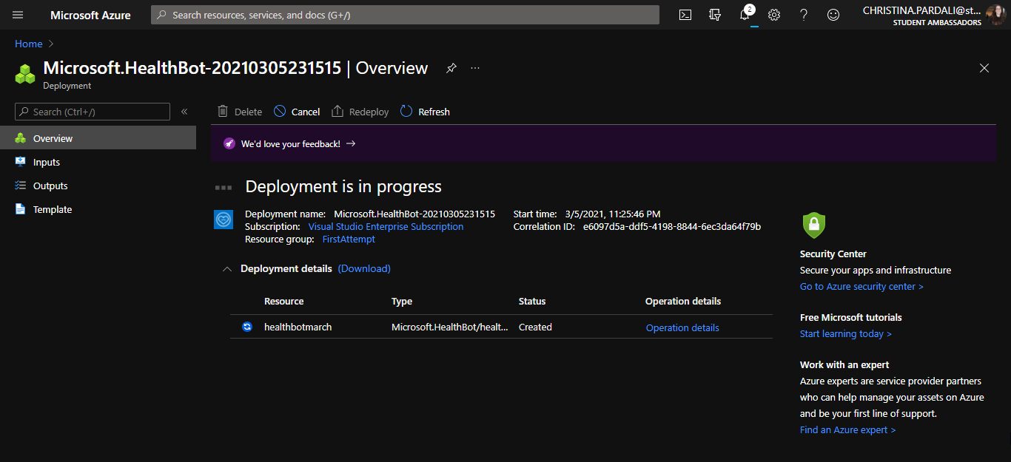
Create your first Health Bot Demo

Slide 19
Different types of scenarios

Slide 20
What is a scenario?
Scenarios are conversational flows that are pre-programmed into the bot. Typically, when a scenario is triggered by the bot, the user completes a series of questions and answers until the scenario is complete.
There are two types of scenarios:
1. Built-in
2. Custom scenarios

Slide 21
Built-in scenarios
Built-in scenarios are hard coded bot scenarios available out of the box to your end users.
Triage/symptom checker
General information about conditions and symptoms
Drugs and medication

Slide 22
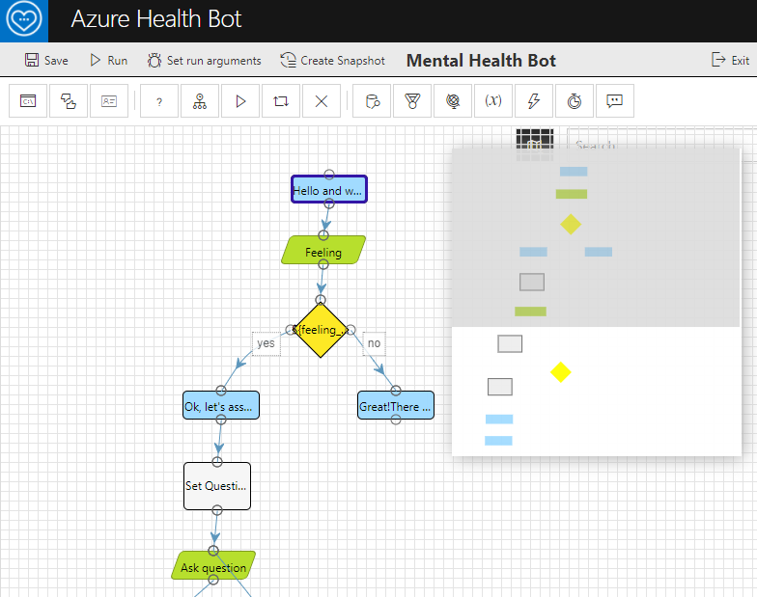
Custom scenarios
The Health bot platform provides tools in the management portal to build your own custom scenarios. Custom scenarios are very powerful and can integrate with external data sources to create engaging experiences for your end user.

Slide 23
Scenario Templates
Scenario templates enable you to quickly build out custom scenarios for popular Healthcare use cases. ​
When you import a template into your Health Bot instance it will automatically create the assets required for that scenario, such as language models and data connections.

Slide 24
Resources
Azure Health Bot documentation : https://docs.microsoft.com/en-us/azure/health-bot/
LUIS : https://www.luis.ai/home
GitHub repo : https://github.com/ChristinaPa/Microsoft-Learn-Student-Ambassadors-Events

Slide 25
Thank you! Questions?

Slide 26
